Slide 1
10 Minute Content Marketing Tasks
Module 1 - Why 10 Minute Tasks

Slide 2
Parkinson’s Law
"work expands so as to fill the time available for its completion"

Slide 3
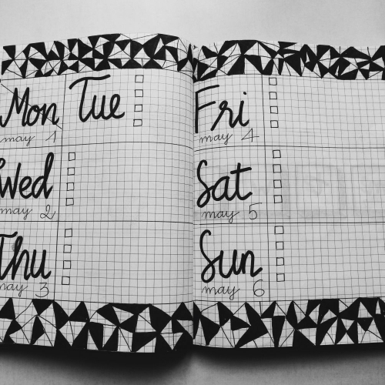
Consistency Is Key
Taking action.
Small things add up.
You’re building habits.
Think of it as a daily workout that will make you better and stronger.

Slide 4
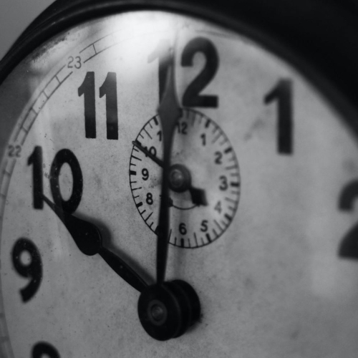
Why 10 Minutes?
It’s easy.
It’s a sprint.
It’s flexible.

Slide 5
Ten Minutes Add Up Quickly
6 Ten Minute Tasks Per Day
5 Focused Hours of Productivity
Equivalent of 10 to 30 hours of regular “work”
What if ...
You can do more?
You build on what you’re doing?
You only work on the most important stuff?

Slide 6
Don’t Miss Our 10 Minute Task Guide & Companion Journal
We put together a simple guide on the basic idea behind ten minute tasks and how to apply them to all areas of your life.
You can find it and the companion journal in the member area.
Download them and use them!

Slide 7
What’s next?
Module 2: 10 Minute Content Brainstorms
Module 3: 10 Minute Blog Posts
Module 4: 10 Minute SEO Tweaks
Module 5: Facebook In 10 Minutes Per Day
Module 6: Instagram & Pinterest In 10 Minutes Per Day
Module 7: Set Up Social Media Automations
Module 8: 10 Minute Traffic Tasks
Module 9: 10 Minute Tasks Outside The Box
Module 10: Content Marketing Goals & Tracking Progress

